Slide 1
Sammies_Demographics
File created on: 10/13/2023 2:24:44 PM

Slide 2
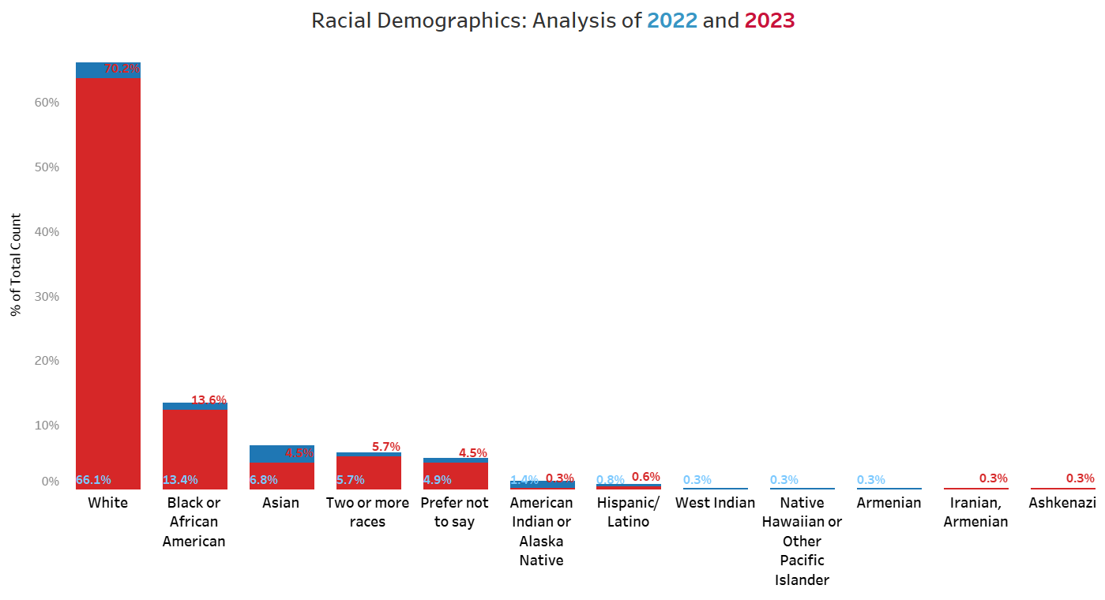
In contrast to 2022, there has been a 4.1% decrease in overall racial diversity in 2023.
The most significant decrease is observed within the Asian groups, marking a noteworthy 2.3% decline.

Slide 3
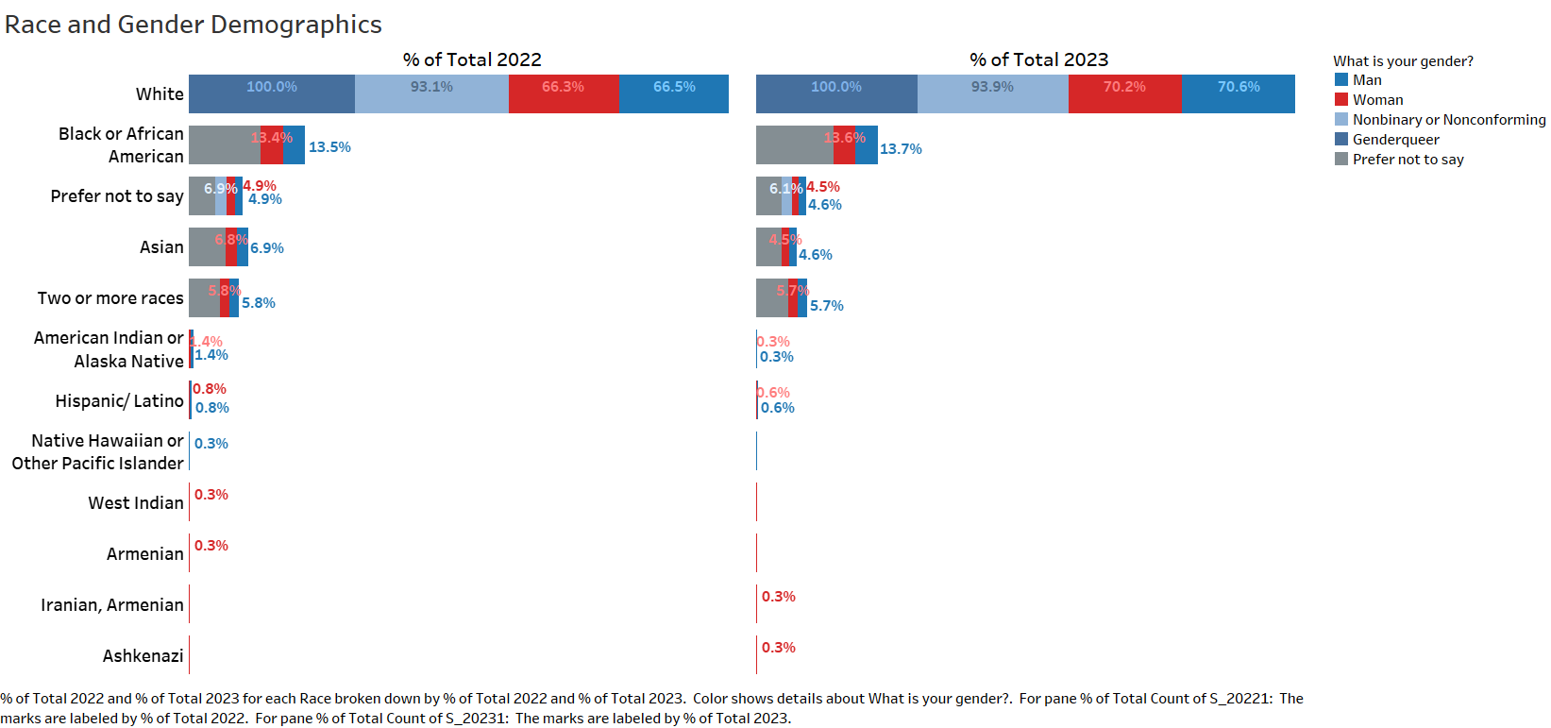
Gender diversity showed a modest uptick in 2023, with a 0.6% increase in individuals identifying as Nonbinary/Nonconforming.
Collectively, there has been a marginal 2% reduction in the number of individuals identifying as men or women.
Nevertheless, this change in diversity is exclusively noted within the White demographic.

Slide 4
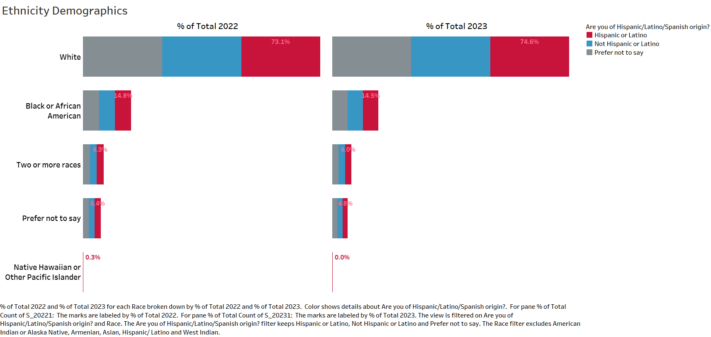
In comparison to 2022, there has been a notable 3.7% upswing in the Hispanic/Latino demographics.

Slide 5
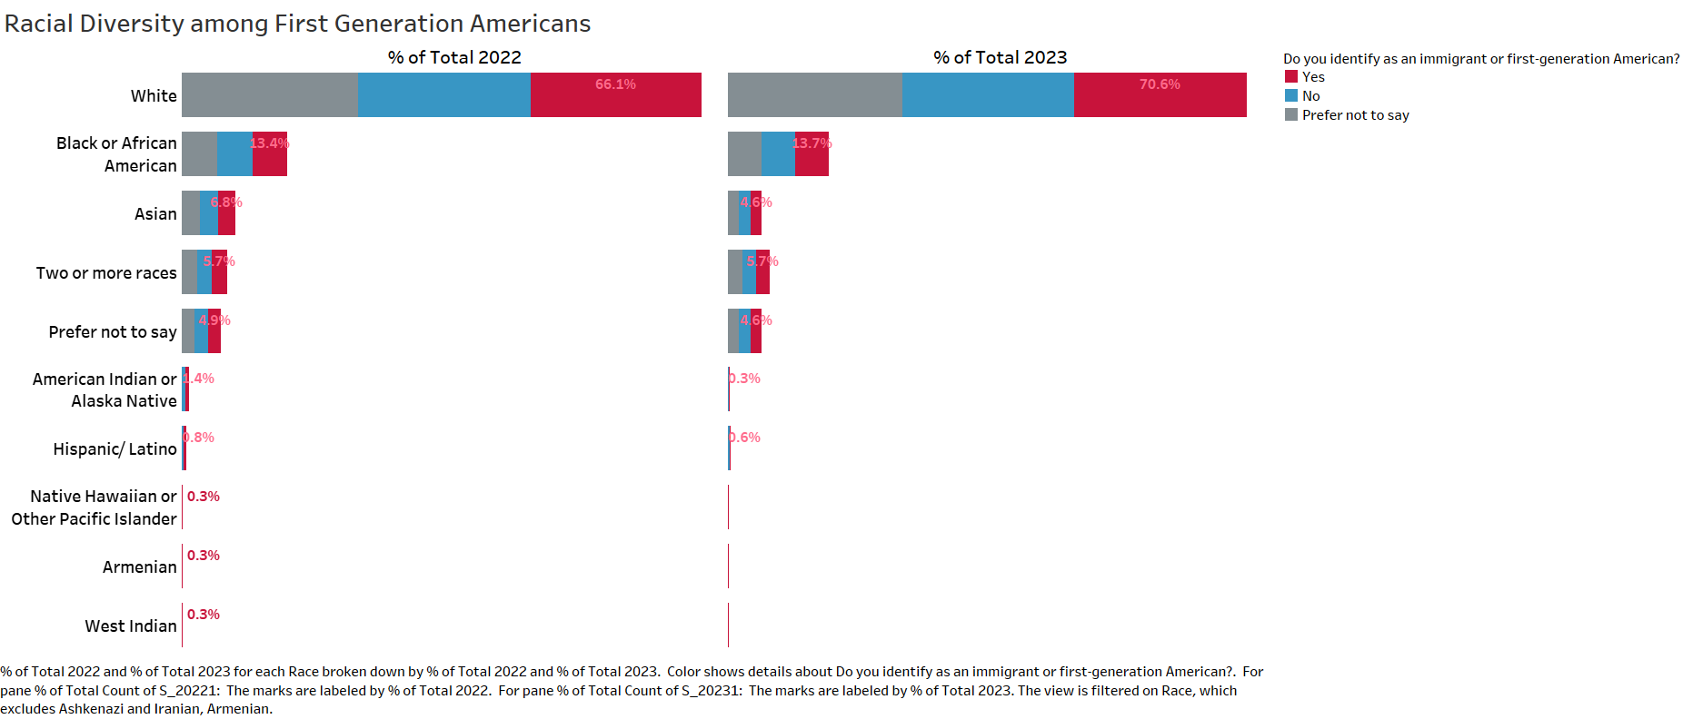
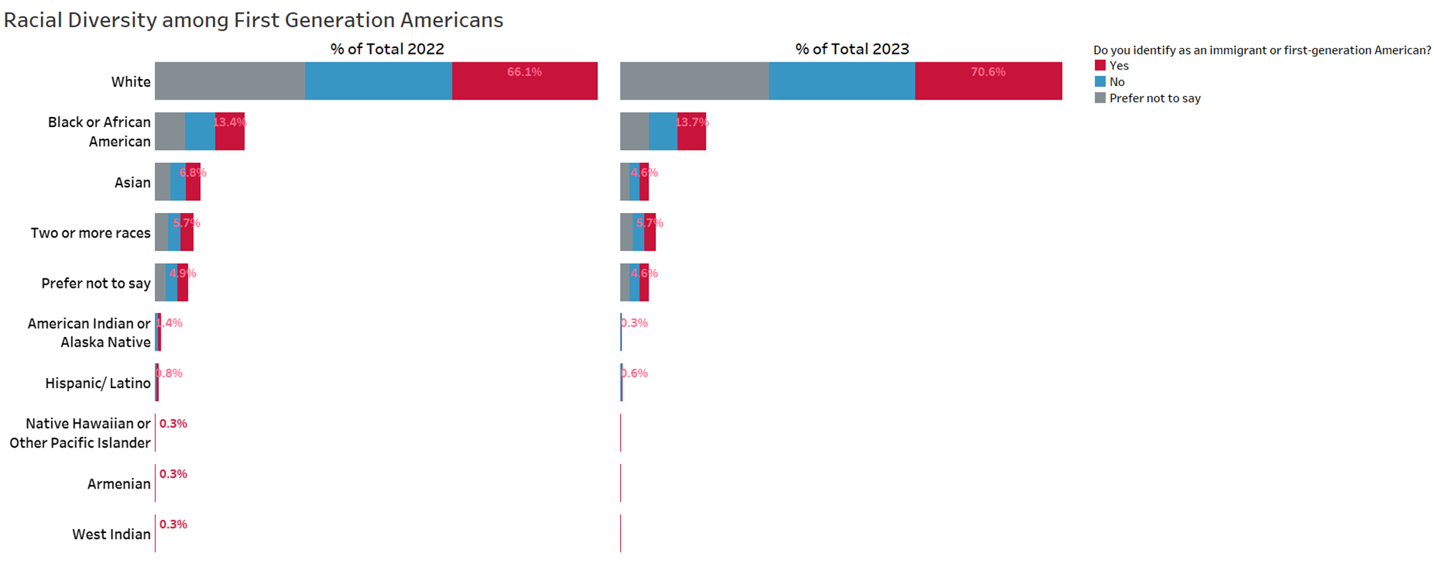
Since 2022, there has been a 0.2% overall reduction in individuals identifying as immigrants or first-generation Americans.
In the realm of racial diversity, this surge is predominantly noticeable among first-generation White immigrants, showcasing a substantial 4.5% increase since 2022. Conversely, the corresponding figures indicate a slight 0.3% uptick for Blacks or African Americans.
Moreover, it is particularly noteworthy that there has been a significant decline in the Asian demographics, reflecting a 2.2% decrease compared to the previous year.

Slide 6
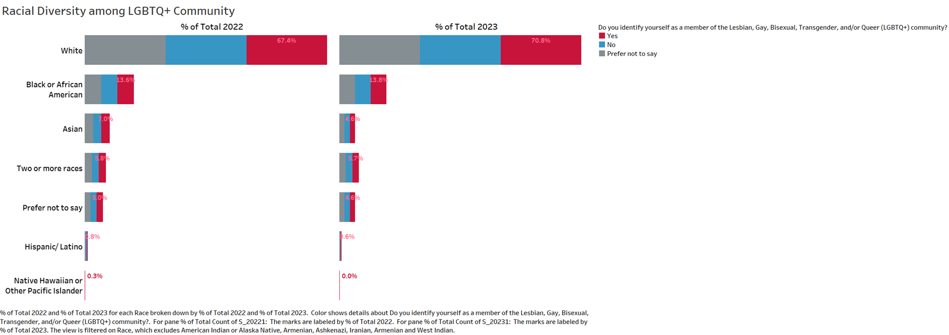

The data reveals a 0.8% rise in individuals identifying as part of the LGBTQ+ community compared to 2022.
This upward trend is shown by a 3.4% increase among Whites and a 0.2% increase among Blacks or African Americans.
However, this upward trend is accompanied by a decline in Asian (2.4%) and other demographic groups.

Slide 7
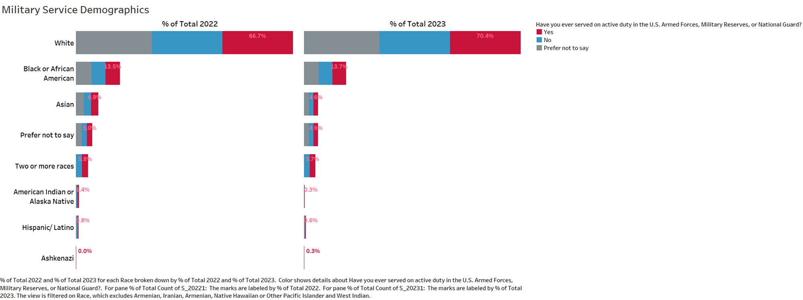

Notable 2.5% increase in military service compared to 2022.
This rise is evident in both White and Black or African American groups (3.7% and 0.2% respectively), starkly contrasting with a decline observed in the Asian demographics (2.3%).

Slide 8
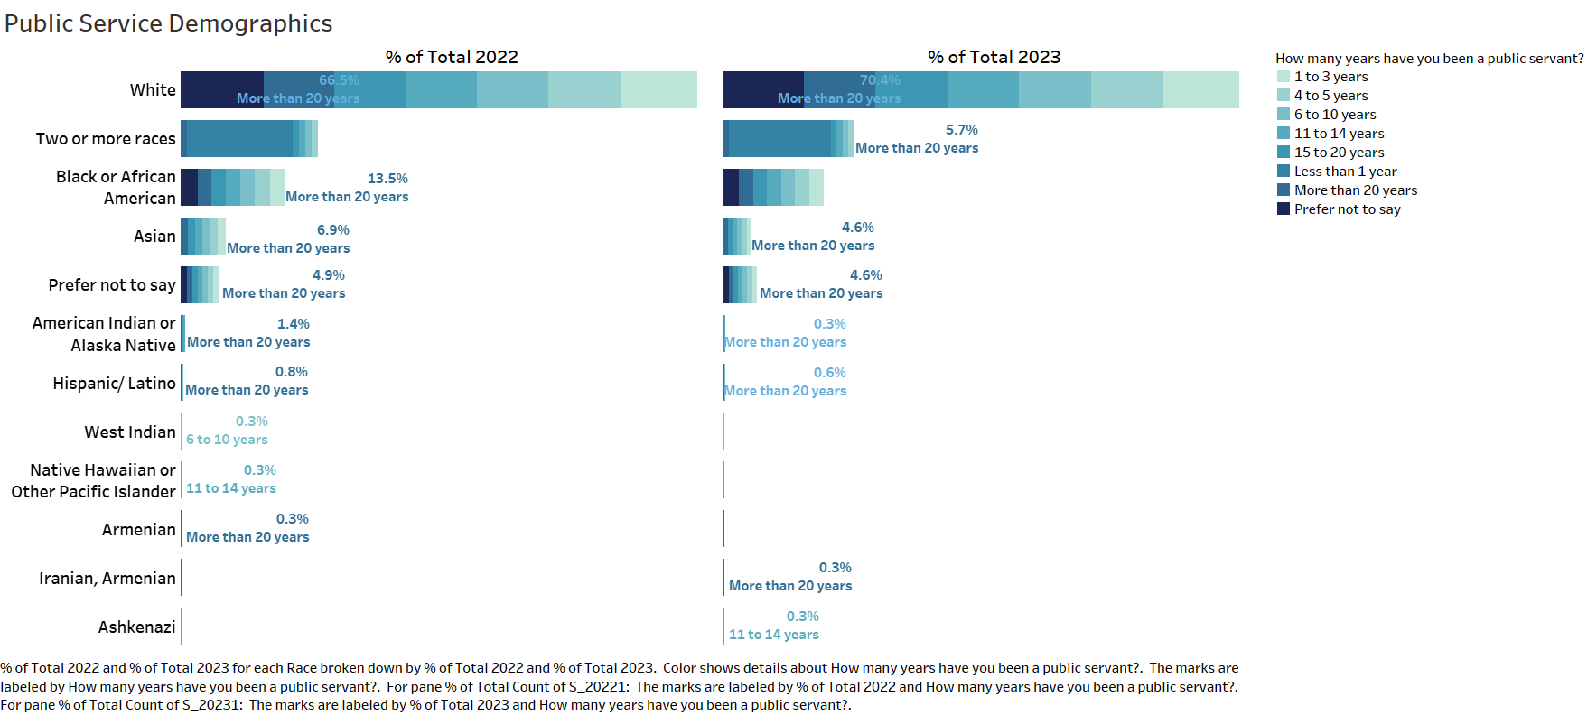

The most remarkable uptick is observed in 11 to 14 years in public service group, with a notable 3.7% increase.
Conversely, the most substantial decline compared to 2022 is witnessed among those who served for more than 20 years, reflecting a significant 5.3% decline.

Slide 9
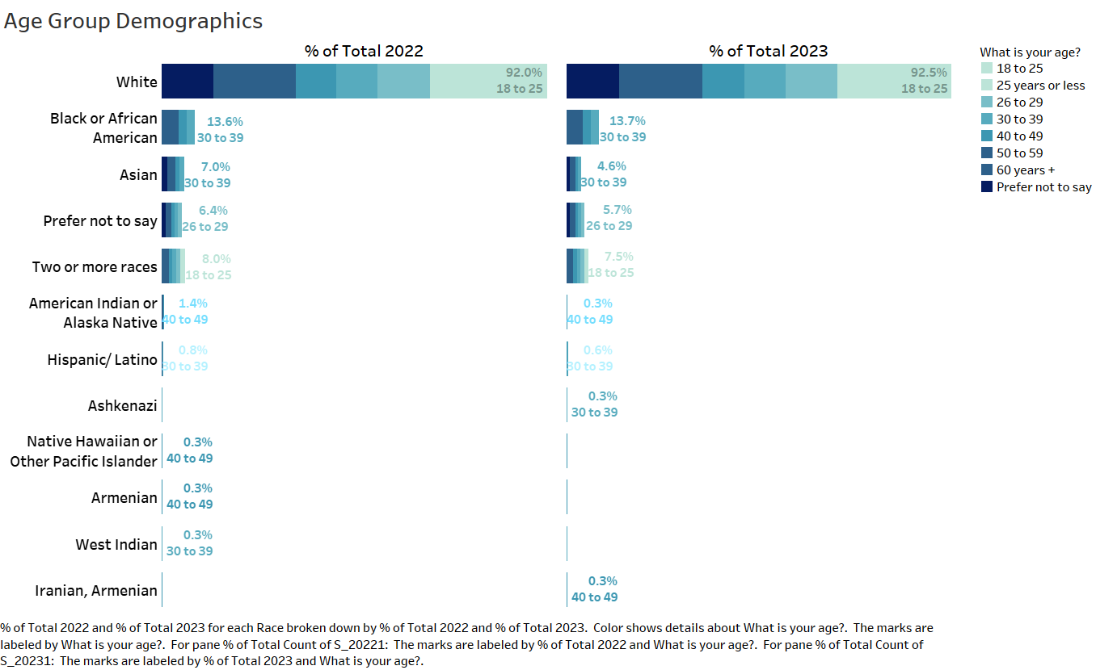

The demographic breakdown highlights a surge in individuals identifying as 60 years and older, marking a substantial 5.7% increase.
In contrast, a pronounced decline of 8.8% is evident in the age brackets of 40 to 59.
Additionally, a modest uptick of about 1% is discernible in the younger population over the course of the year.
When examining the data based on racial demographics, the pattern indicates there has been a decrease in the number of individuals within each racial group compared to the previous year.

Slide 10
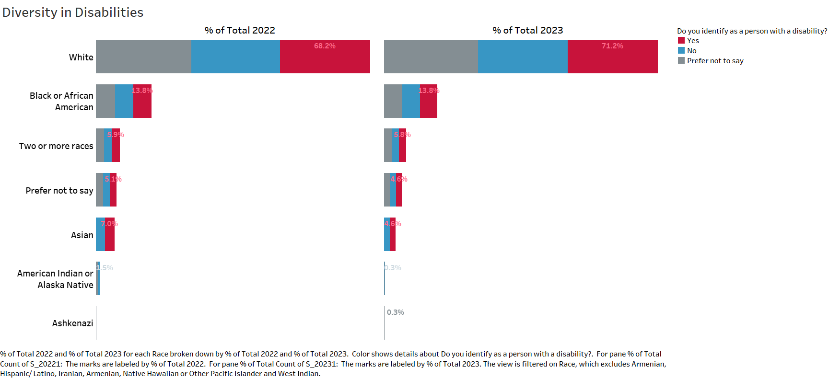
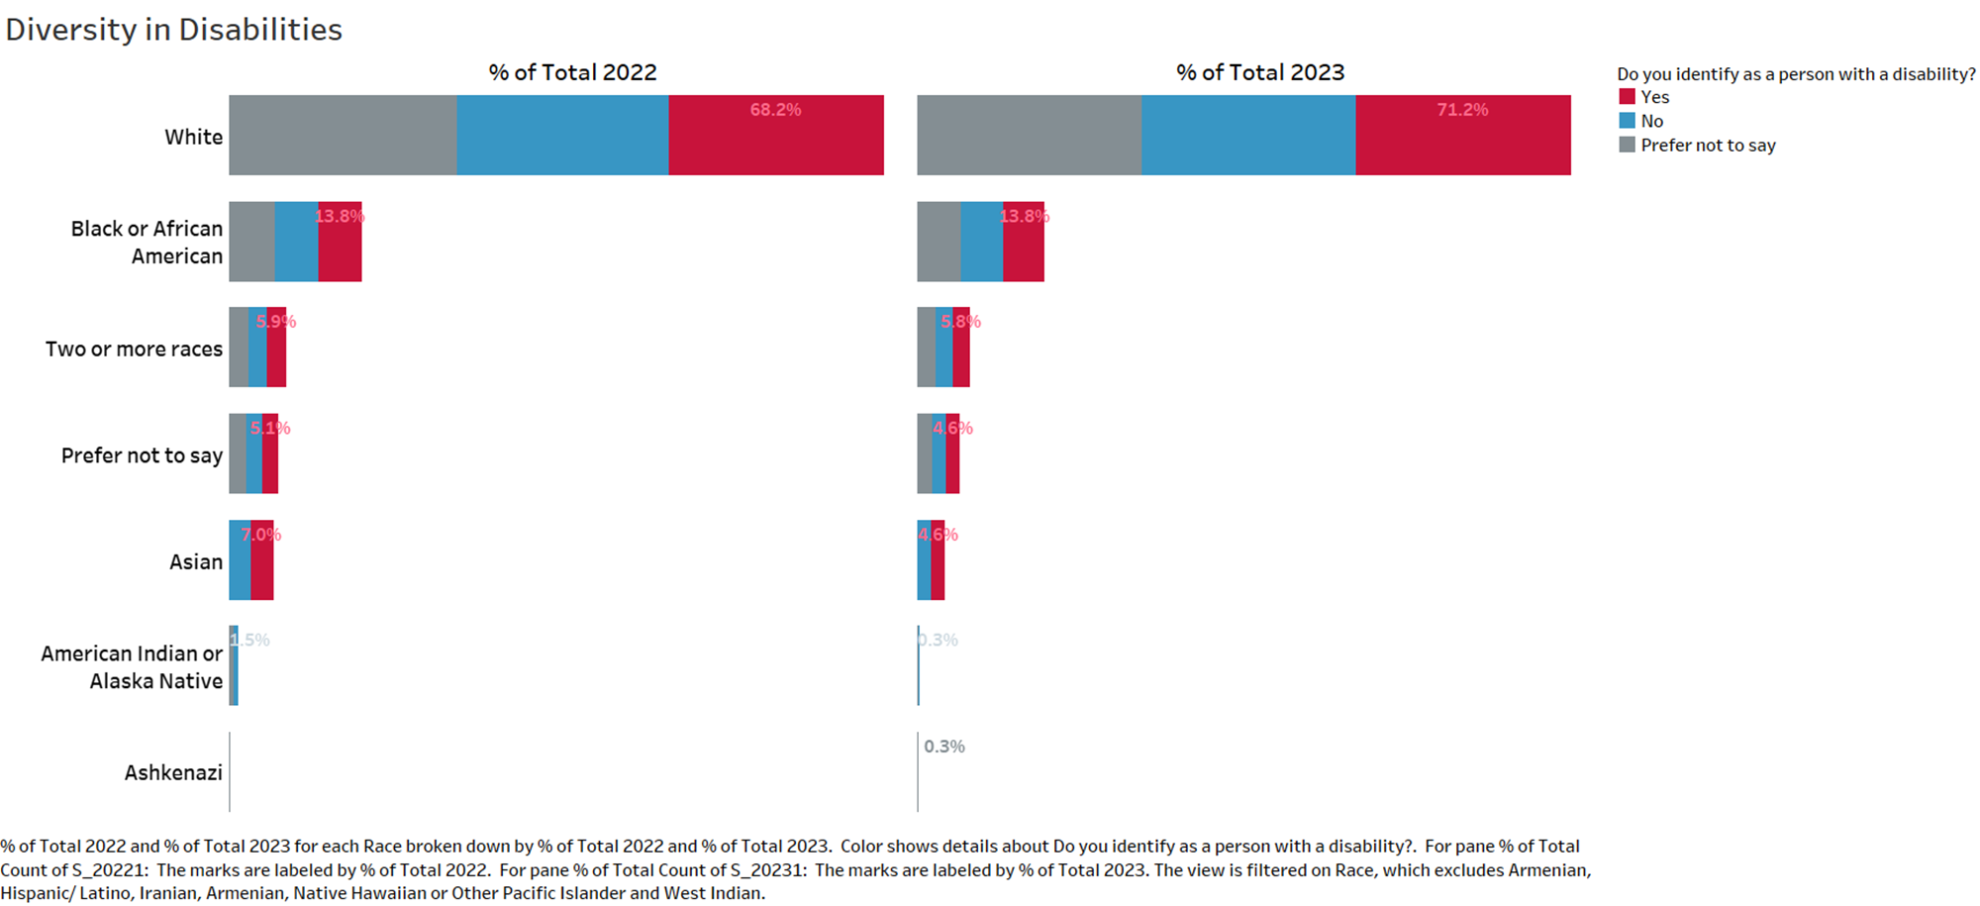
The statistics highlight an approximate 1% rise in individuals identifying as persons with disabilities compared to the figures from 2022.
This increase is exclusively observed within the White demographic, reflecting a 3% increase.

Slide 11
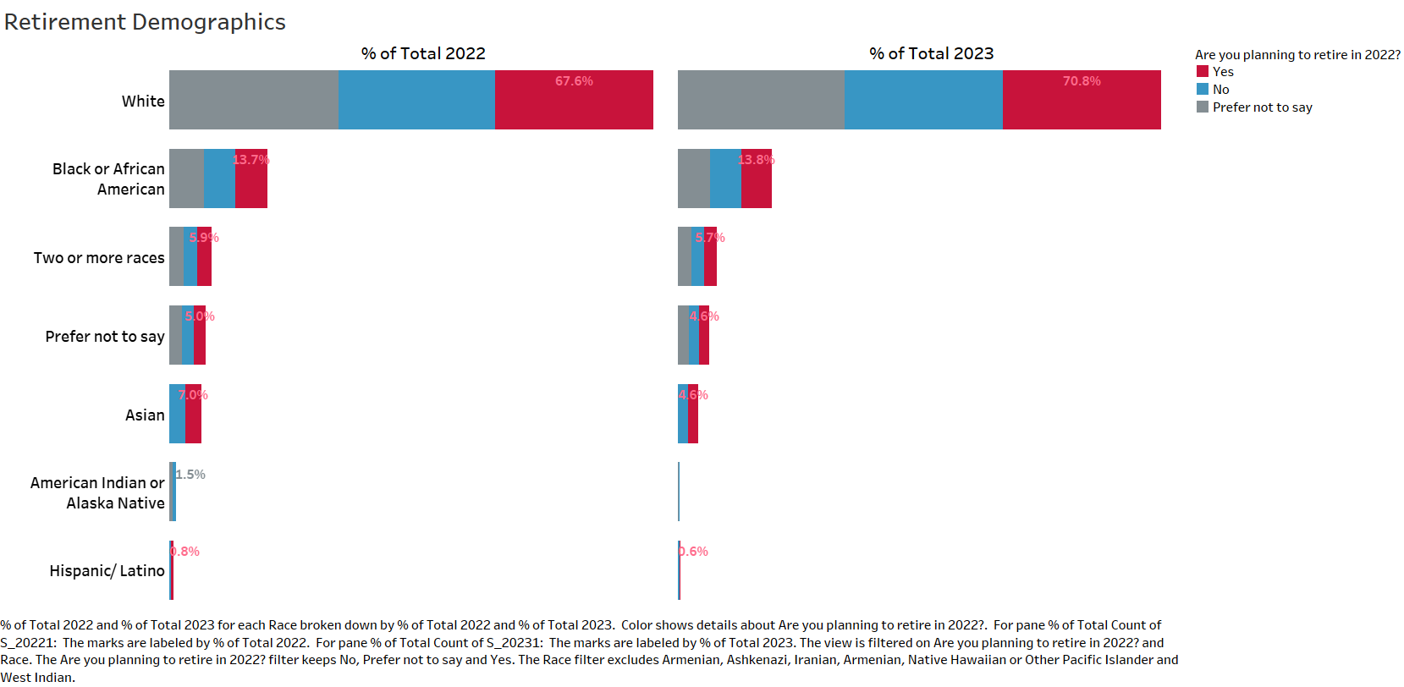
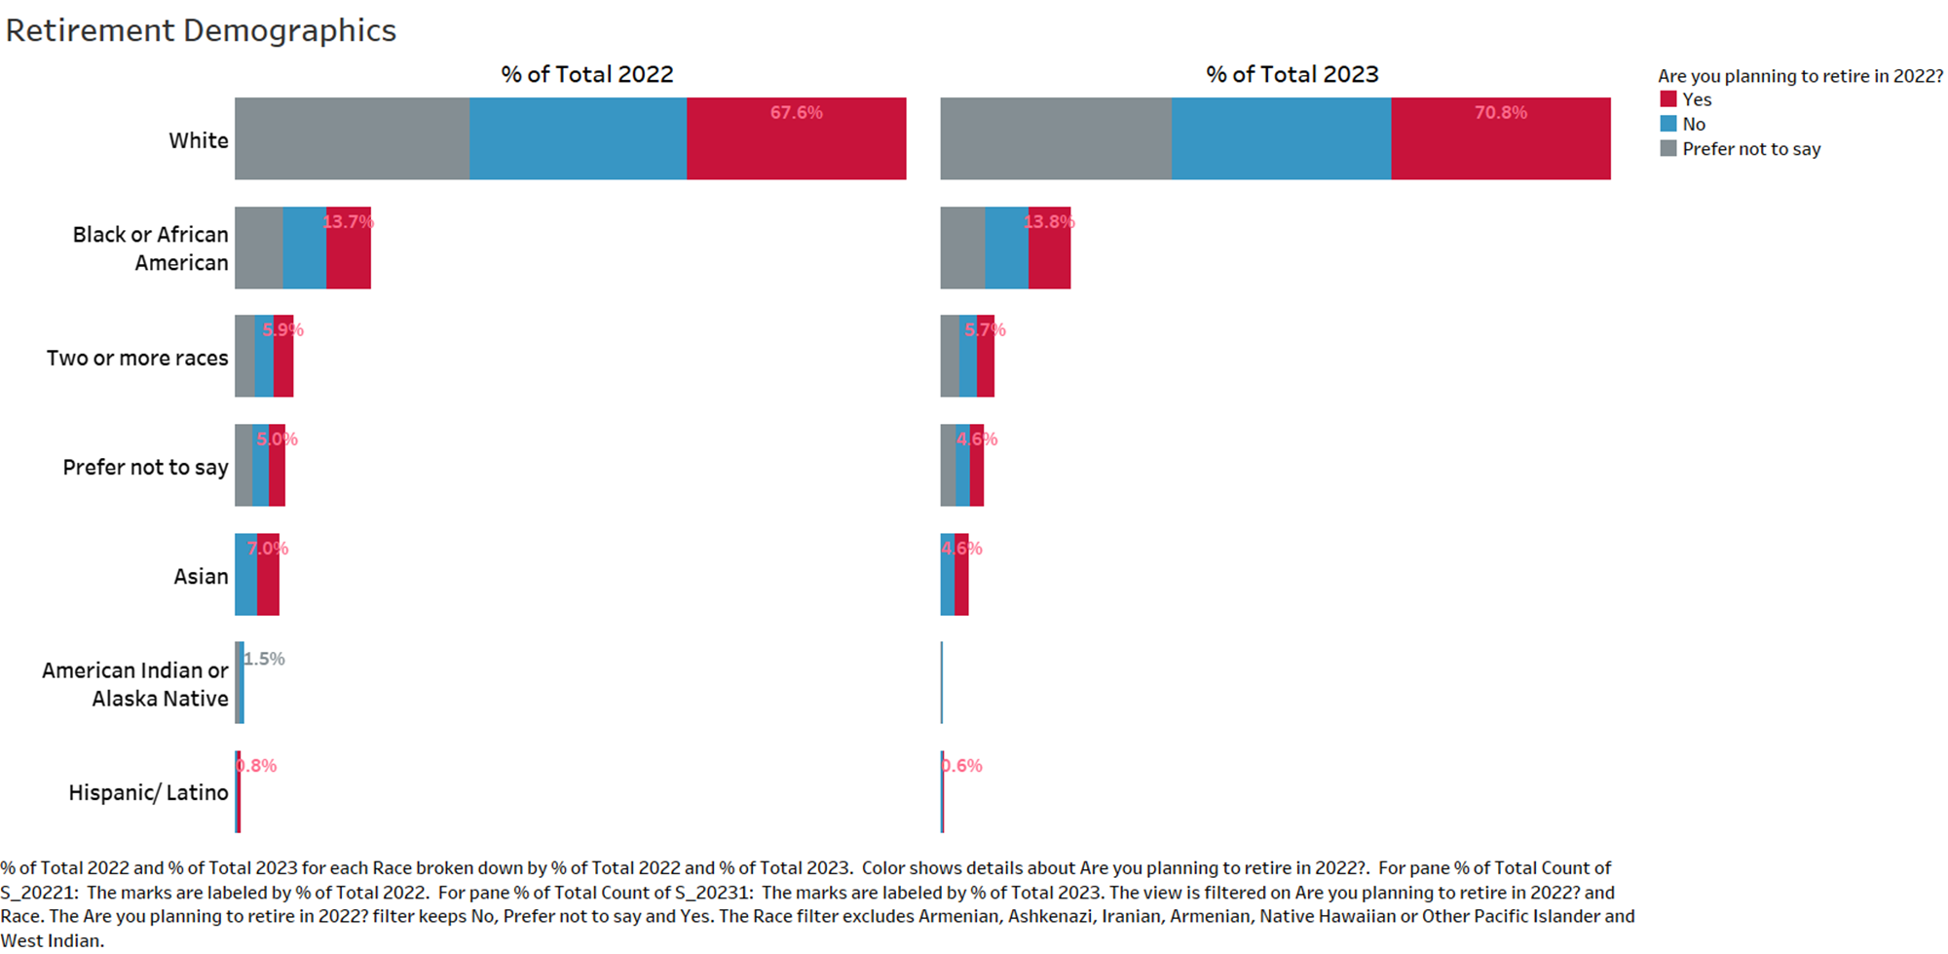
The data reveals a 2% decrease in the number of individuals retiring in 2023 compared to the preceding year.

